Slide 1
Learning objectives of Brucellosis lectures :
Identify the brucellosis and the causative micro-organism
Clarify the routs of transmission and pathogenesis
Discuss the presentation of brucellosis and mention the differential diagnosis of this febrile illness.
Identify the systemic complications of the disease
Explain the investigations needed to the diagnosis
Discuss the important lines of treatment
Discuss the methods of prevention of the disease

Slide 2
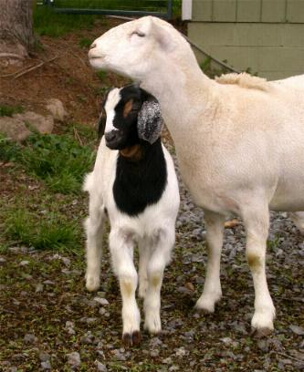
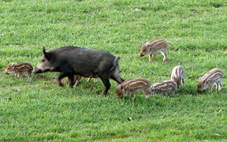
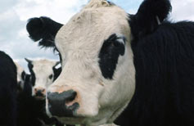
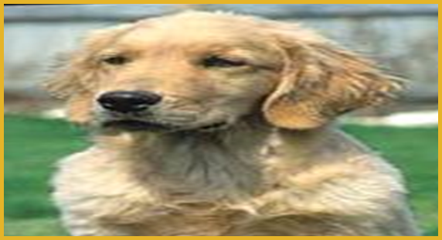
Brucellosis
Malta fever, Mediterranean fever
Undulant fever, Gastric fever

Slide 3
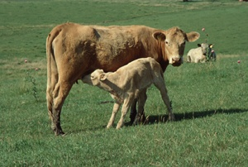
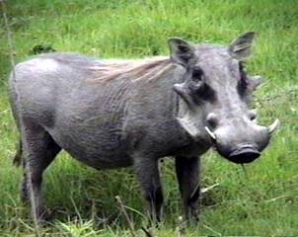
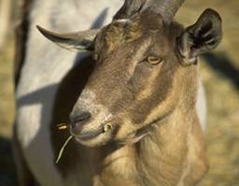
Brucellosis
Species | Natural Host
B. abortus | cattle
B.melitensis | goats, sheep
B. suis | swine
B. canis | dogs, other canids
Systemic bacterial enzootic infection caused by:
Brucella sp. Gram negative coccobacillus

Slide 4
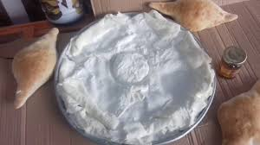
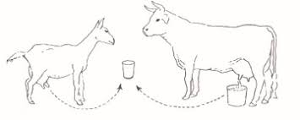
Transmission
Ingestion unpasteurized milk/raw dairy products, uncooked meat
Contact with infected farm animals or its products as in slaughterhouse , meat-packing , plant employees, veterinarians.

Slide 5
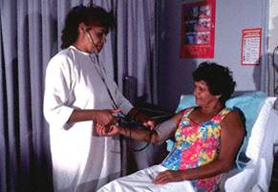
Clinical features
The acute illness : start few days up to three months
Fever : the most common symptom, with high "spikes" that usually occur in the afternoon with night sweating rigor.
Back pain& Body-wide aches and pains.
Poor appetite and weight loss.
Headache.
Weakness.
On Exam : 1- enlarged lymph nodes & spleen → hypersplenism and thrombocytopenia
2- Tender Sacroiliac and spine

Slide 6
Chronic Localised infection 30 % :
chronic fatigue , depressive episodes, arthritis
Neurobrucellosis
meningitis, stroke, haemorrhage
uveitis , Retinal thrombophlebitis
Cranial nerve palsy
Myelopathy
Heart
Endocarditis , myocarditis
Notes:
Complications are seen occasionally, particularly in the undulant and chronic forms. The most common complications are arthritis, spondylitis, epididymo-orchitis and chronic fatigue. Neurological signs occur in up to 5% of cases. They may include personality changes, meningitis, encephalitis and peripheral neuropathy. Uveitis, optic neuritis and papilledema have been reported. Endocarditis is one of the most serious complications, and is often the cause of death in fatal cases. Many other organs and tissues can also be affected, resulting in a wide variety of syndromes including nephritis, dermatitis, vasculitis, lymphadenopathy, deep vein thrombosis, granulomatous hepatitis, cholecystitis, osteomyelitis, anemia, leukopenia and thrombocytopenia. Abscesses can occur in internal organs.

Slide 7
4. Hematological :
Pancytopenia
splenic abscess
hilar lymph. Node
5. Skeleton :
Suppurative arthritis
Spinal spondylitis or sacroilitis and Paravertebral abscess
Osteomyelitis

Slide 8
Differential diagnoses of Brucellosis
Lymphoma
Tuberculosis
Infective endocarditis
Malaria
Infectious mononucleosis
HIV infection
Depression
Leishmaniasis and Relapsing fever

Slide 9
Diagnosis in Humans
Culture Blood,
2. Serology like RBT, tube agglutination and ELISA
3. PCR
4. X-ray :
erosion of antero-superior corner of lumbar vertebrae)
marked osteophytosis.
Notes:
Microscopic examination of stained smears can be useful for a presumptive diagnosis, particularly if the direct examination is supported by other tests. They are not truly acid-fast; however, they are resistant to decolorization by weak acids, and stain red against a blue background with the Stamp's modification of the Ziehl-Neelsen method. Other organisms, such as Coxiella burnetii, can resemble Brucella. In humans, the definitive diagnosis is by culture or serology. Brucella species can sometimes be isolated from the blood early in the infection; bone marrow is often positive at this stage. Occasionally, bacteria can be recovered from the cerebrospinal fluid, urine, or tissues. Most Brucella species form colonies within a few days, but isolates from seals grow slowly and may take 7 to 10 days to become visible on selective media. Brucella isolates can be identified to the species and biovar level by phage typing and cultural, biochemical, and serological characteristics. Most human infections are diagnosed by serology. Tests used include serum agglutination, a modified Coombs’ (antiglobulin) technique, ELISAs, and immunoblotting (Western blotting). Serologic diagnosis is complicated by previous exposures and other factors; a definitive diagnosis usually requires a fourfold rise in titer. Immunostaining can sometimes demonstrate the presence of Brucella spp. in a clinical specimen. PCR techniques can also be used for diagnosis. PCR has begun to gain popularity in the diagnosis of brucellosis due to the high specificity and sensitivity of the test, as well as the quick turn around of results. Chronic brucellosis can be extremely difficult to diagnose if the serologic results are equivocal and the organism cannot be cultured.

Slide 10
KEY POINTS ON THE DIAGNOSIS OF BRUCELLOSIS
In acute brucellosis, isolation of Brucella from blood or other tissues is definitive ,
Culture is often negative, especially in long-standing disease.
Serology is the most generally useful diagnostic procedure approach.
Methods which differentiate IgM and IgG can distinguish active and past infection.
False positive serological reactions may occur.
Skin test reactions indicate past exposure not active infection

Slide 11
Treatment
Mild cases :
doxycycline and rifampin -- for 6 weeks .
2- Sever cases: 3 drugs
Getamicin + dox. + rifamp. For 8 weeks.
3- Pregnancy and children :
Co-trimaxazole + rifampicin for 8-12 wks

Slide 12
Prognosis
_ Rarely fatal <2% (untreated)
Antibiotics necessary
Death usually caused by :
Endocarditis
meningitis
Notes:
Brucellosis is rarely fatal if treated; in untreated persons, estimates of the case fatality rate vary from less than 2% to 5%. Antibiotics are usually the mainstay of treatment; long-term treatment may be required. Some forms of localized disease, such as endocarditis, may require surgery. Deaths are usually caused by endocarditis or meningitis. Although recovery is common, disability is often pronounced depending on the localization of infection and response to treatment. Approximately 5% of treated cases will relapse weeks to months after therapy has ended due to the failure to complete the treatment regimen or infection that requires surgical drainage. Antibiotic resistant strains of Brucella have been reported, but the clinical importance of that fact is not well understood.

Slide 13
Prevention and Control
Pausterization of milk. Susceptible to heat, disinfectant
For occupational exposure, use caution, animal vaccination, protective gloves.
Post-exposure prophylaxis
Notes:
13
Educate those at greatest risk about the routes of transmission of brucellosis. Properly protecting yourself, if you are an “at risk” individual, by wearing gloves, masks, goggles, and coveralls to prevent exposure to tissues and body secretions of infected animals can help. Pasteurization or boiling milk and avoidance of eating unpasteurized dairy products will help decrease human exposure to brucellosis.

Slide 14
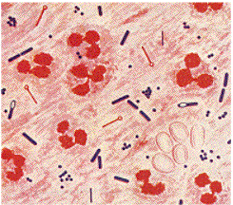
Tetanus
acute bacterial infection caused by Clostridium tetani . anaerobic gram-positive, spore-forming bacteria found in soil , geminate and produce tetanospasmin

Slide 15
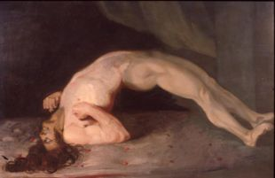
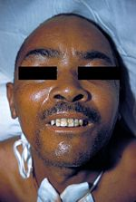
Clinical features
Characterized by : an acute onset of hypertonia, painful muscular contractions (jaw and neck), and
generalized muscle spasms
1-7day,
Generalized T. : Violent painful spasm
lock jaw : is spasm of maseter muscle
Risus sardonicus: contraction of the frontalis and mouth angle.
opisthotonus : arched back + board like abdomin
.

Slide 16
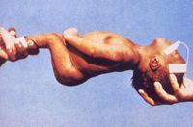
3- Neonatal tetanus
muscle spasms, inability to feed , and seizures. occurs within the first two weeks after birth
4_Spatula test: In tetanus, patients develop a reflex spasm of the masseters and bite the spatula (a positive test).

Slide 17
complications
Laryngospasm
Fractures and dislocation
Hypertension and arrhythmia
Pulmonary embolism
Pneumonia
Malnutrition
Coma, neuropathies, and psychological aftereffects

Slide 18
Differential diagnosis
Meningitis
Low Ca+ or Mg+
Rabies.
Status epilepticus
Multiple sclerosis.
Hysterical

Slide 19
Treatment
tetanus antitoxin
antibiotics (penicillin, metronidazole) , wound debridement
Control spasm
diazepam + quit room
magnesium
human tetanus immunoglobulin – intrathecally
mechanical ventilation
General measures :
* hydration and nutrition
* treat secondary infection

Slide 20
prevention
sterile the injured skin
Active immunization .
passive immunization

Slide 21
Quiz :
All the following are possible causes of body spasm except:
hypocalcemia
Rabies.
Status epilepticus
Hypomagnesemia
Hypokalemia
the answer on google document in classroom:
https://classroom.google.com/c/MzQ4OTEwMjgyMzky?cjc=wz3okqj

